Slide 1
Impact of Social Sciences, Humanities and Arts Conference
The Parallel Session on:
Institutional Strategies for Impact
15 October, 2021

Slide 2
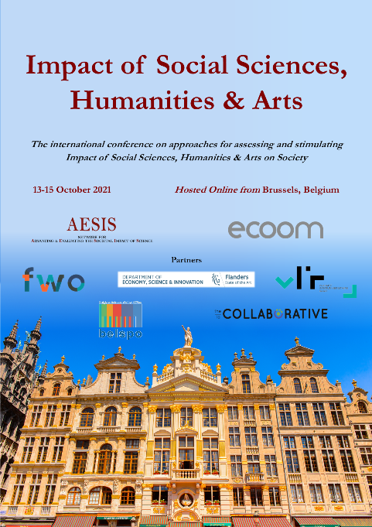
Impact of Social Sciences, Humanities and Arts
13-15 October, 2021
Thomas König (Chair): Head of Strategy and Scientific Services at the Institute for Advanced Studies (IHS), Austria
Noël Klima: Head of Knowledge Transfer, Engagement and Societal Impact at IDC Crime, Ghent University
Aurelija Povilaike: National Contact Point at the Research Council of Lithuania
Lorenzo Compagnucci: Postdoctoral Researcher in Applied Economics at the Department of Law of the University of Macerata
Overview of the Speakers
#SSHA21

Slide 3
Impact of Social Sciences, Humanities and Arts
13-15 October, 2021
Noël Klima
Head of Knowledge Transfer, Engagement and Societal Impact at IDC Crime, Ghent University
#SSHA21

Slide 4
Developing and embedding transversal SSH-lead interdisciplinary structures to stimulate and support societal impact creation
AESIS – ECOOM, Impact of Social Sciences, Humanities & Arts – The international conference on approaches for assessing and stimulating Impact of Social Sciences, Humanities & Arts on Society
Noël Klima, online, 15/10/2021
Notes:
Fostering the ideal conditions for setting-up/supporting interdisciplinary research projects, creating a climate to create interdiciplinarity
IDC Crime deals with the domain of deviance and its (policy) response, as well as in the areas of crime and security in a broad sense.

Slide 5
Ghent University
Notes:
Comprehensive university, one of the biggest in BE
Shanghai ranking 2018: 61 > best ranked Belgian University

Slide 6
INSTITUTIONAL POLICY on societal impact
Institutional research policy plan (2017)
Quality, values and impact
Reinforcement through university's own Special Research Fund
Umbrella for policy plan on societal value creation of research (2015) with focus on Policy, Platforms, People
Areas of embedded transversal research collaboration
Development cooperation (collaboration with Global South)
Business Development Centres
Interdisciplinary consortia with focus on societal impact (IDC)

Slide 7
From SSH consortia to Interdisciplinary consortia (IDC) (1)
Stage 1: SSH Consortia (2012)
Alpha Action Plan Goals: better quality + better visibility / appreciation + methods and incentives (biometrics bias, higher individuality, less ‘big’ funding, smaller groups, high teaching load, societal value creation
Set-up: Budget: € 4,25 million over 5 years
Focus areas: research professors, sabbaticals, research evaluation, research coordinators
Clustering existing expertise among 5 pilot SSH consortia with dedicated research coordinators (postdoc level with 5-year contracts) supporting:
Financial potential (both identifying funding opportunities and grant writing)
Collaboration
(Societal) value creation
Hope to be self-sufficient
Need for structural support
Medieval History
Global Studies
Clinical Psychology
Criminology
Business models & Innovation
Notes:
In parallel: New guidelines on research assessment Flemish Academic Bibliographic Database (VABB) New policy plan on societal value creation (IM-pact)
Selection procedure
Consortium proposal (bottom-up, multidisciplinary topic, future potential, added value of coordinator)
Selection committee > Faculty advice > Research Council > Executive Board
Recruitment of coordinator (selection by consortium
SSH Research Assessment Exercise
5 Faculties during 5 years: Discipline-specific assessment by an external peer review panel, including a site visit
Self reflection on strategy, quality, and impact of research (using a amended template)
Specific programme evaluation (mid-term): SWOT analysis
Specific programme evaluation (final):
Crucial role in collaboration and putting SSH and impact on the map
Need for critical mass
Specific versus generic role

Slide 8
From SSH consortia to Interdisciplinary consortia (IDC) (2)
STAGE 2 – IDC Consortia (2018)
5 SSH consortia becoming 4 IDC’s
University wide open call for 6 IDC’s
Organisation, Interdisciplinarity, Impact: impact plan with impact pathways
Assessment procedure
Assessment panel with representatives of Research Council and civil society
New career model “IDC-Coordinator”
Postdoctoral level
Same salary scales and evaluation procedures as professors, but contractual
Specific job description with indicators for development
Open-ended contract
Administratively embedded in faculty and department structure
Topics: Medieval History, Mental Health, Global Studies, Crime & Security, Aging, Sustainability of City & University, Human Rights, Migration, Work, Digitization
Notes:
Evaluation process
Evaluation of consortium (4 years) + evaluation of coordinator (2/4 years)
Qualitative approach
Deliverables (retrospective): organisation, interdisciplinarity, impact case study + Planning (prospective): impact plan

Slide 9
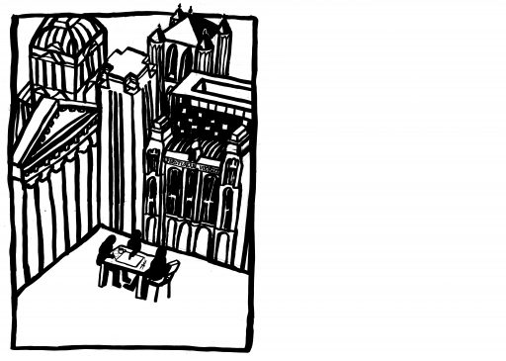
10 Interdisciplinary research consortia with focus on societal impact (IDC)
https://www.ugent.be/en/research/science-society/idc/overview.htm

Slide 10
Some Characteristics
SSH-led IDC consortia in majority as conterpart to TechTrans Business Development Centers (diversity and complementarity)
Close cooperation with EU team and Research Department (network)
Seize between 20 and 60+ professors from different disciplines (critical mass)
Different thematic focus (societal challenges)
Independent in approach and main priorities (autonomy)
Indefinite in time (long term strategy)
Fixed annual budget (autonomy)
Cooperation between 10 consortia and coordinators (peer exchange)
New specific career model for IDC coordinator (adequacy)
Support of interdisciplinary bottom-up cooperation

Slide 11
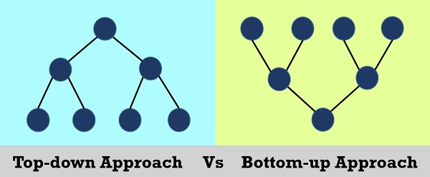
Embedding-Challenges
Seize of consortia
Additional burden for researchers (funding and value creation)
Extra added value and individual researcher needs
Unlimited amount of opportunities with regard to societal challenges (focus/time)
Work on many levels at the same time (challenge and advantage)
Hybrid and transversal structure in top-down university administration (complementarity)
Labelling and external marketing
Building trust, dedication and commitment among all members as well as mutual recognition and understanding between coordinators, researchers and central university research (policy) departments takes time

Slide 12
more potential
Structural data sharing across disciplines (open science)
Structural resource sharing (communication)
Structural impact literacy development (training)
Extension of service through extra supporting staff
Co-create policy and infrastructure
Group effort vs individual research culture
Long-term relationship of trust with stakeholders
More joined forces to feed big changes

Slide 13
www.ugent.be/crime/en
@UGent_Crime
https://crimeatugent.com/
Notes:
De Universiteit Gent lanceerde thematische interdisciplinaire consortia met focus op maatschappelijke impact (IDC). Het IDC Crime, Criminology & Criminal Policy verenigt 21 professoren en hun medewerkers uit verschillende disciplines in zes vakgroepen die interdisciplinair werken rond thema's die verband houden met veiligheid, criminaliteit en deviantie in een lokale, nationale, Europese en internationale context. In nauwe samenwerking met verschillende onderzoeksinstellingen van de Universiteit Gent bundelt het consortium de beschikbare kennis en expertise aan de Universiteit Gent. Het consortium bevordert kennisuitwisseling, kennisvertaling en maatschappelijke innovatie. Het versterkt maatschappelijke waardecreatie die leidt tot maatschappelijke impact en stimuleert synergiën en samenwerking met academische, beleids- en praktijkpartners uit verschillende disciplines.

Slide 14
Dr Noël Klima IDC Crime, Criminology & Criminal Policy noel.klima@ugent.be +32 9 264 67 32 https://www.ugent.be/crime/en https://crimeatugent.com/
Universiteit Gent @Crime_UGent IDC Crime, Criminology & Criminal Policy

Slide 15
Impact of Social Sciences, Humanities and Arts
13-15 October, 2021
Aurelija Povilaike
National Contact Point at the Research Council of Lithuania
#SSHA21

Slide 16
AESIS conference
(Inter) National and Instutional transformative approaches enabling integration and stimulation of societal impact: UK and Lithuania
Aurelija Povilaike, National Contact Point (NCP) for
Lithuanian Research Council Email: aurelija.povilaike@lmt.lt
LinkedIn
@povilaike

Slide 17
Introduction
Ø Profesional at the Interface of Science (PIoS)
Ø Experience in research development, research policy and impact (UK and Lithuania)
Ø Experience with SSHA disciplines and multidisciplinary teams

Slide 18
History of Impact in the UK
1994 – ROPA pilot scheme (Waldegrave)
1995 – ROPA rolled out to all RCs, subsequently mainstreamed
2006 – Warry Report recommended Research Councils (RCUK) demonstrate their economic impact 2008 – ‘Impact Plans’ first included on grant applications
2009 – ‘Impact Plans’ become ‘Pathways to Impact’ 2009 – First proposals to include impact in REF 2010 – Pilot of impact case studies for REF
2011 onwards – Impact confirmed as part of REF and Impact continues to be important to RCUK 2013 – RCUK Centres submit impact for evaluation
2013 – UK HEIs submit impact as part of REF2014 2014 – Increased emphasis on impact in H2020 2015 – REF Impact Case Studies Published
2018 – REF impact Case Studies value increases to 25%
2020 – “Pathways to Impact” in UKRI applications are cut, but impact evaluated as part of the proposal 2021 – UK HEIs submit Impact Case Studies as part of REF 2021

Slide 19
Research Excellence Framework (REF) in United Kingdom
In the REF, impact is defined as an effect on, change or benefit to the economy, society, culture, public policy or services, health, the environment or quality of life, beyond academia. Impact has been considered a beneficial addition to the REF and will be worth 25% in the REF2021 assessment
The general criteria used to assess the impact of research in REF2021
Reach: is understood as the extent and/or diversity of the beneficiaries of the impact, as relevant to the nature of the impact. Reach will be assessed in terms of the extent to which the potential constituencies, number or groups of beneficiaries have been reached;
it will not be assessed in purely geographic terms, nor in
terms of absolute numbers of beneficiaries. The criteria will be applied wherever the impact occurred, regardless of geography or location, and whether in the UK or abroad
Significance: will be understood as the degree to which the impact has enabled, enriched, influenced, informed or changed the performance, policies, practices, products, services, understanding, awareness or wellbeing of the beneficiaries.
National strategies: transforming the science eco-system (UK)

Slide 20
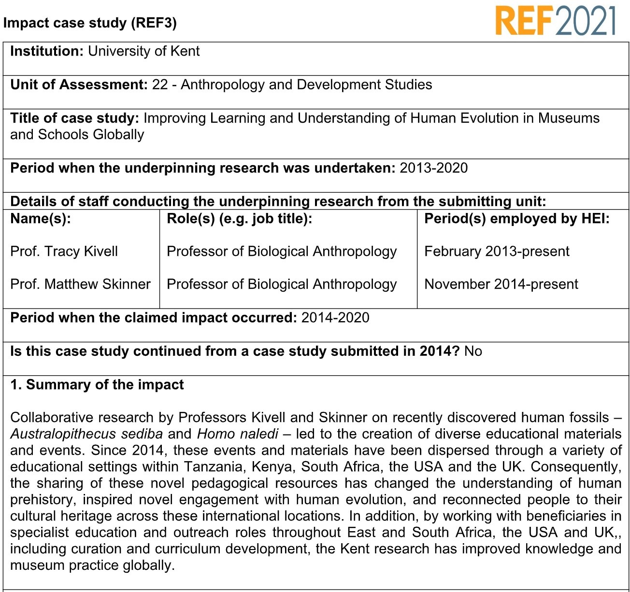
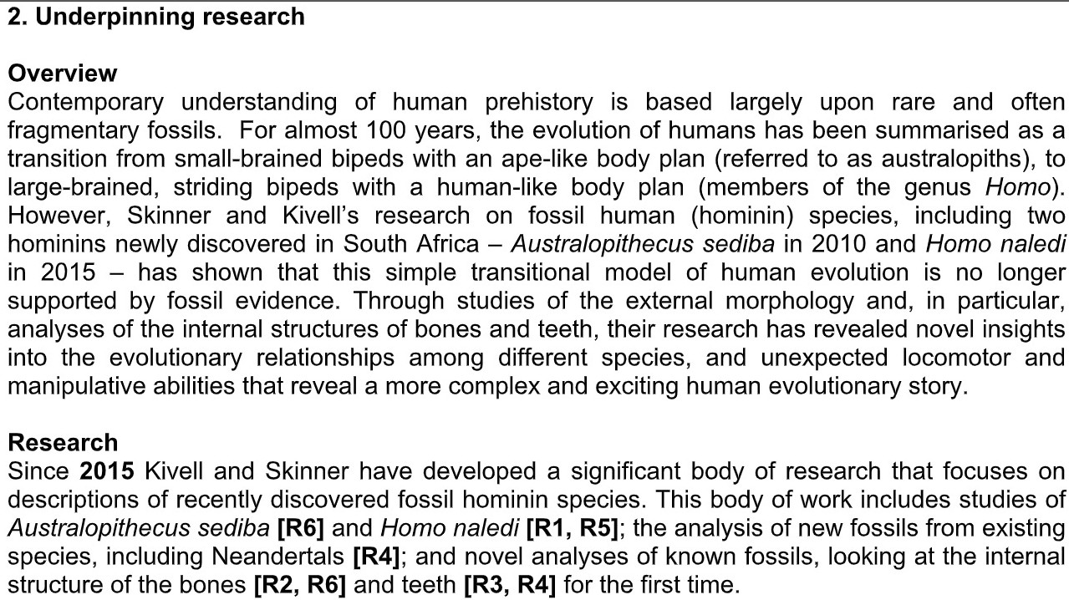
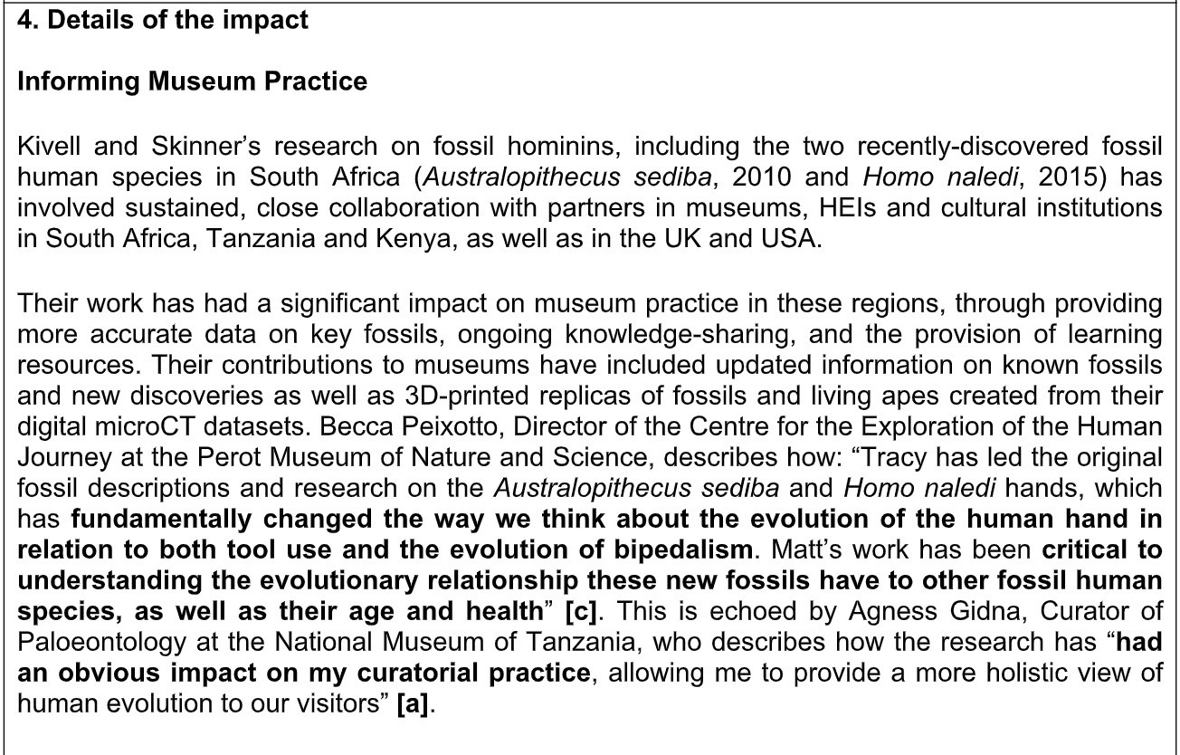

Slide 21
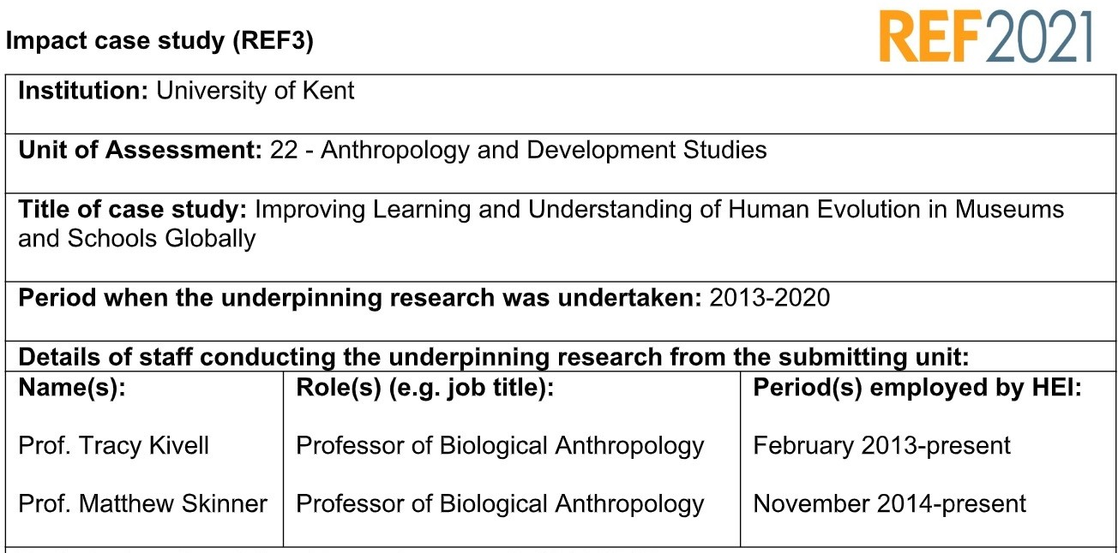
Impact of this case study:
ü Changing museum practice
ü Transforming Visitor Interpretation
ü Improving Children’s Understanding of Heritage in South and East Africa
ü Supporting Curriculum Development in HEIs
ü Engaging and Informing the Wider Public
*Both scientists hold ERC grants

Slide 22
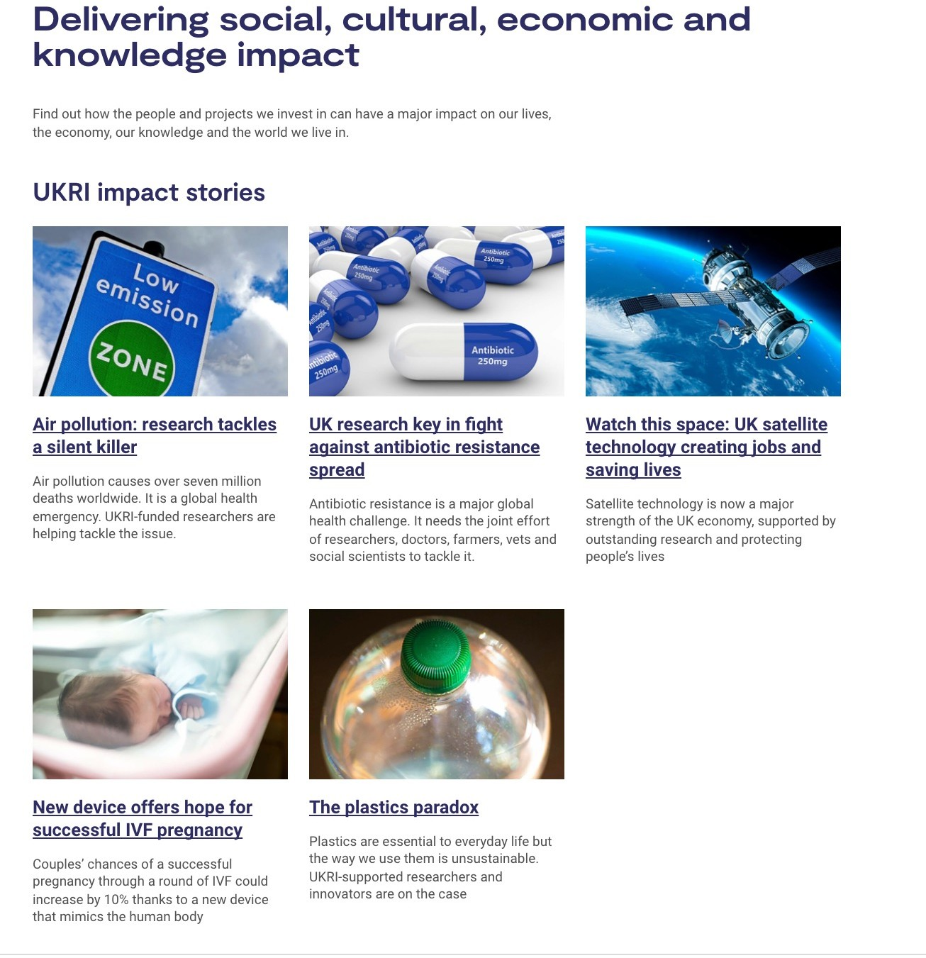
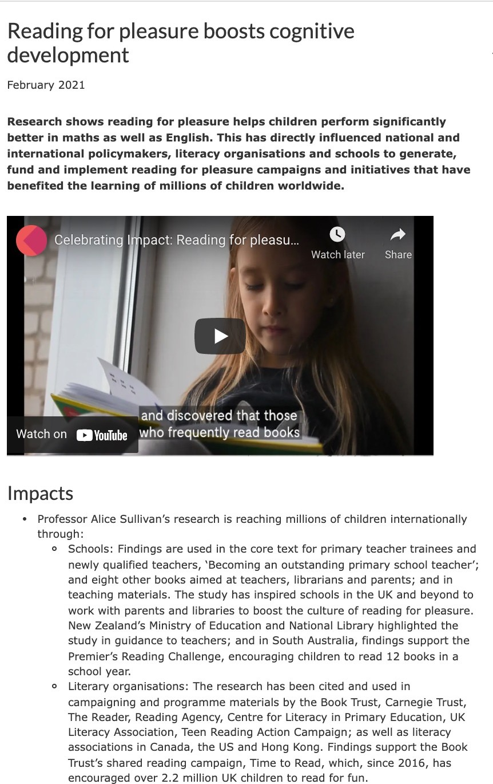
National Funder strategies: transforming the science eco-system (UK)
For over 13 years “Impact”was included as a mandatory category in the UKRI applications
Since March 2020 Impact is now a core consideration throughout the application process and should be reviewed as such
Impact is celebrated

Slide 23
Lithuania progress strategy “Lithuania 2030”
National strategies: transforming the science eco-system (Lithuania)
Research Assessment exercice, RAE (since 2005)
Smart Specialisation (S3) strategy

Slide 24
Research Assessment Exercice (RAE):
Informs research policies and institutional strategies
Generates evidence for science policy
Increases accountability for public spending
Stimulates efficiency in research activity
Demonstrate that investment in research is effective and delivers public benefits
Encourages improved research performance (in the form of higher quality, greater social relevance, improved efficiency or a number of other dimensions)
Allows to compare the state of research performance internationally (and nationally)
Provides feedback for assessment participants
Provides input for the balanced development of research and its funding

Slide 25
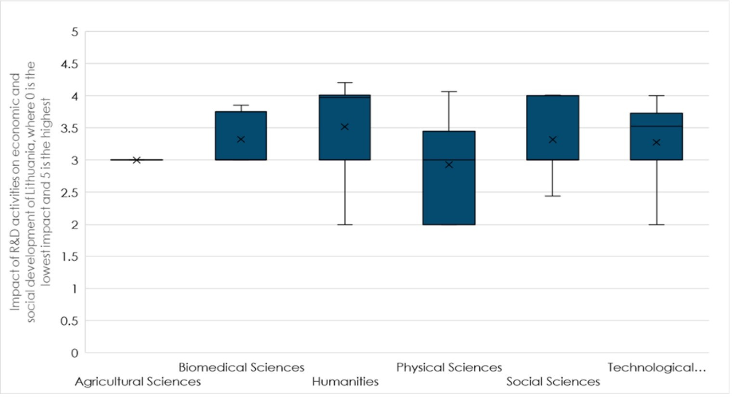
RAE: Societal and Econonic impact
The impact of R&I activities on socio- economic activities is significantly lower, due to the insufficient resources for R&I in HE and the structural barriers for research – business collaboration.
HEIs contribute to the socio-economic development of Lithuania primarily through the implementation of the teaching mission. The challenge is diversification of efforts to research and the third mission
(JRC Technical report, Higher Education for Smart Specialisation: The case of Lithuania , 2020)

Slide 26
National & Funder strategies: transforming the science eco-system (Lithuania)
Task 1
Task 2
Carry out fundamental research on the concepts of modernity; use a range of theoretical, comparative
Examine social, economic and political modernisation conditions, and the impact upon the public and cultural development; carry out historical and comparative research of political and national community, disclose the
and interdisciplinary methods; carry out an
Lithuania progress strategy “Lithuania 2030”.
National Research Programme administred by RCL – “Modertinity in Lithuania”
Challenges: lack of reporting on impactful activities and eveidene gathering
integrated research on the
factors and processes of modernisation of culture, forms and images of modern culture, evolution of the modern man, his
forms and the dissemination of the
modern political ideas and structures, political and civil culture
cultural and artistic expression

Slide 27
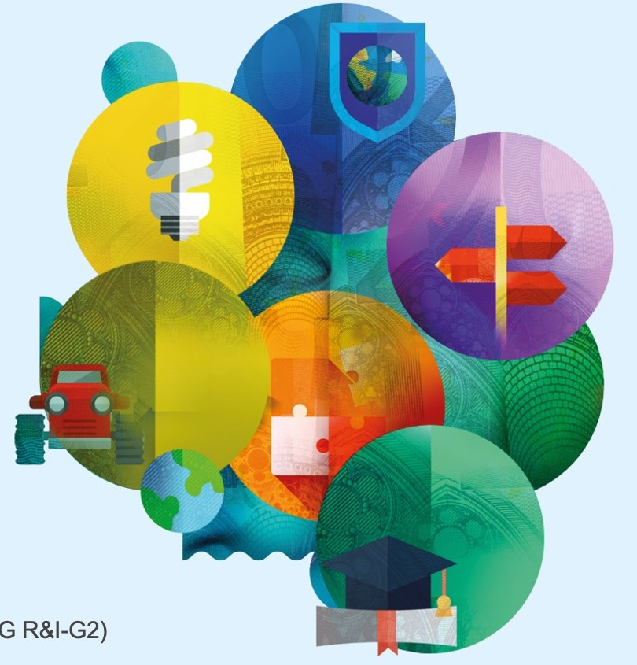
International Funder strategies: transforming the science eco-system (EU)
Horizon Europe – impact driven framework programme. Pathways to Impact section and nine Key Impact Pathways (KIPs)
Scientific impact: (1) Creating high-quality new knowledge; (2) Strengthening human capital in R&I; (3) Fostering diffusion of knowledge and Open Science
Societal Impact: (4) Addressing EU policy priorities & global challenges through R&I; (5) Delivering benefits and impact via R&I missions; (6) Strengthening the uptake of R&I in society; and
Economic / Technological Impact: (7) Generating innovation-based growth; (8) Creating more and better jobs; and (9) Leveraging investments in R&I

Slide 28
How can we integrate impact in the institutional strategy to support a mandate for societal wellbeing?
(Inter) National strategies lead to the implementation of Institutional strategies and change:
v Institutional Impact strategies
v Impact Units/Departments
v Internal Impact funds (Stategic Impact, Capturing Impact)
”Producing world-leading research outputs and ensuring that research development, innovation, enterprise and social impact are embedded in all our research activities”, Vice-Principal QMUL (Research & Innovation)

Slide 29
Culture
ØRecognising trans/multi/inter- disciplinary differences
ØRewards (National, institutional, departamental)
ØRecognition (through academic promotion, changing some of the existing practices)

Slide 30
RAAAP-2: Impact: National & Institutional
RAAAP-2 [2019]

Slide 31
The strategies should no act on their own, the change of the eco-system should be a collaborative effort.
National level assessment frameworks (REF, RAE)
Funding agency requirements (national and international)
National level R&I strategies
Institutional strategies and structures to support the impact
Academic culture change

Slide 32
Thank you!
aurelija.povilaike@lmt.lt
LinkedIn @povilaike

Slide 33
Impact of Social Sciences, Humanities and Arts
13-15 October, 2021
Lorenzo Compagnucci
Postdoctoral Researcher in Applied Economics at the Department of Law of the University of Macerata
#SSHA21

Slide 34
The University of Macerata: SSHs, Third Mission and Entrepreneurship Education
Lorenzo Compagnucci
Postdoctoral Researcher in Applied Economics University of Macerata – Department of Law
Office Valorisation of Research ILO and Placement
October 15th, 2021 – AESIS Conference - Impact of Social Sciences, Humanities & Arts

Slide 35
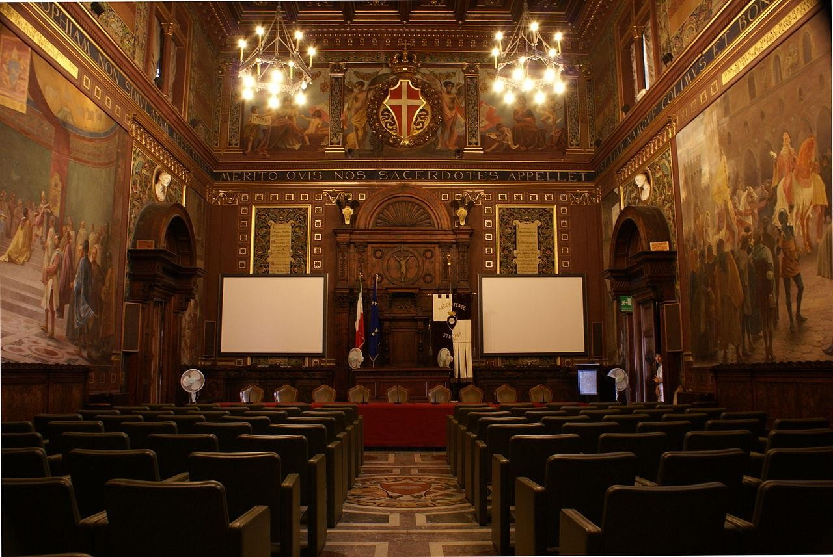
The University of Macerata
Facts and figures: an overview
Video presentation of UniMC _click here
Total student population _11,000 International students _3,000
University
Departments _5
Museum _1
Libraries _25
Ph.D. School _1
Confucius Institute _1
Staff
Faculty _275
Visiting Professors _15 per year
Language Teaching Assistants _11
Administrative and Technical staff _271
lorenzo.compagnucci@unimc.it

Slide 36
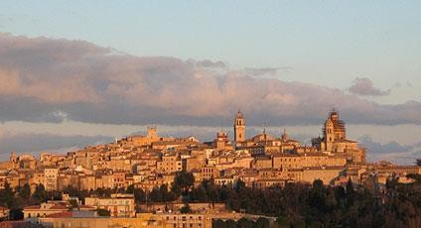
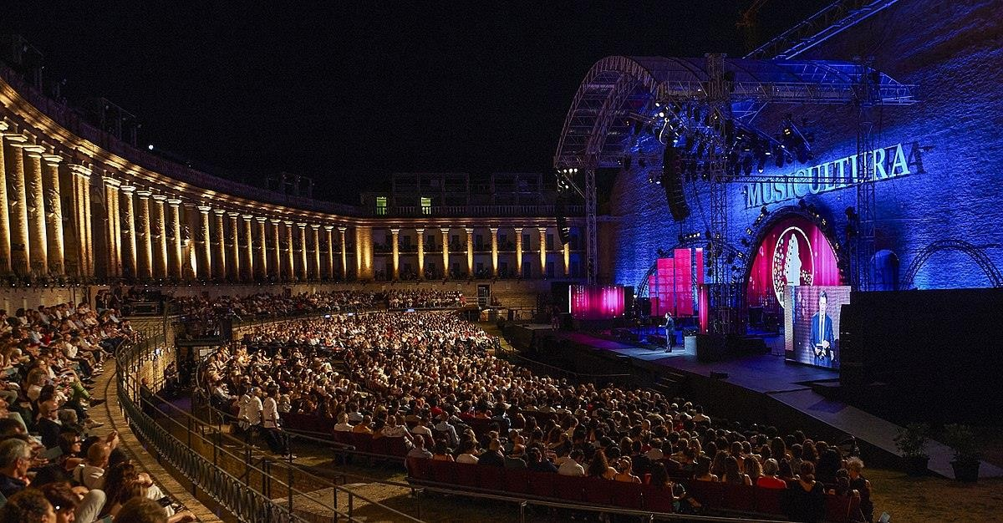
Marche Region and Macerata
lorenzo.compagnucci@unimc.it

Slide 37
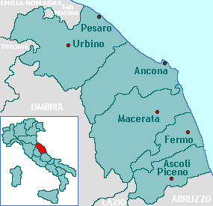
Marche Region and Macerata
Population _1.5 million
GDP _42 billion euros (2.4% of Italian GDP)
Manufacturing districts: mechatronics; shoes and fashion; furniture
Tourism sector
Biological farming
Education _4 universities
Structural issues: 2008 economic and financial crisis; ability to innovate; attraction of skilled human capital; ability to penetrate international markets
Smart Specialization Strategy
lorenzo.compagnucci@unimc.it

Slide 38
The Third Mission of the University
Universities have historically played a central role in promoting and guaranteeing education
as a crucial factor for both economic and human capital growth
In the last twenty years, in the knowledge economy, universities have also begun to act as key players for social growth. Industry, governments and civil society have strengthened their relations with academia which is increasingly invited to support technological progress, innovation processes and social inclusion
Along with teaching and scientific research, universities have embraced a novel Third Mission (TM) which has been broadly described as a multidisciplinary, complex and evolving phenomenon
TM seeks to stimulate the opening of academia towards the socio-economic ecosystem
Following the global financial and economic crisis of 2008, the reduction in public funding
has further stimulated interest in the economic impact of universities and TM actions
Universities must comply with the provisions on financial liability. They must demonstrate
the legitimacy and effectiveness of their expenditure
The question does not concern whether or not to invest in universities, research and TM. Time and resources should be invested in planning and implementing strategies to stimulate the use of scientific results while maximizing their impact
lorenzo.compagnucci@unimc.it

Slide 39
The strategy of the University of Macerata
Humanism, innovation, creativity, culture, digitalization and internationalization are the drivers that shape UniMC strategy to support young talents and the growth of the local community
Since 2013, UniMC has been engaged in a variety of TM initiatives, focusing on tools to promote and “entrepreneurial approach” among undergraduates, postgraduates and scholars in SSHs, stimulation innovation and creativity
University as a facilitator between local actors (indsutry, public bodies, schools, associations) that interact in a continuous and co-creative process to foster local development and sustainability in its of economic, social and environmental dimension
Marche Region is one of the four Italian regions hit by the earthquakes in 2016. Since these terrible events, UniMC has intensified its relations with local stakeholders, promoting several TM initiatives to contribute to recover the areas hit by the disaster
In this context, Marche Region is still one of the most specialized Italian regions in the Cultural and Creative sector. In particular, in 2017, the Province of Macerata Province (NUTS3) was one of the top twenty Italian provinces in terms of C&C sector added value (6.2% on regional basis) and employment (7.1% on regional basis) (Symbola, 2019)
lorenzo.compagnucci@unimc.it

Slide 40
Humanism to support innovation
The strategy of the University of Macerata
Understanding complex socio-economic challenges
Suggesting co-created solutions by adopting an interdisciplinary approach
lorenzo.compagnucci@unimc.it

Slide 41
The strategy of the University of Macerata
February 2013: UniMC set up the Office Valorisation of Research – ILO and Placement to contribute to addressing the challenges related to the TM of the university, the development of the local community and the employability of students
Activities within the university, including scholars, staff and students, to promote the culture of the TM in the context of SSHs and an “entrepreneurial” approach to teaching, research and knowledge transfer
Actions towards the socio-economic ecosystem, including entrepreneurs, schools, associations and the civil society, to propose the co-creation of research projects and to encourage stakeholder engagement in intersectoral initiatives
Targets
Promote soft skills
Promote and support a culture of innovation, creativity and entrepreneurship
Strengthening relationships with local stakeholders
Strengthening relationships with local stakeholders
Creating opportunities for student training in local, national and international firms
Working with STEM universities and high schools in the Marche Region and other Italian regions, to develop interdisciplinary and intersectoral projects to transfer knowledge to both market and society at large
Joining national and international networks of incubators and professional associations
lorenzo.compagnucci@unimc.it

Slide 42
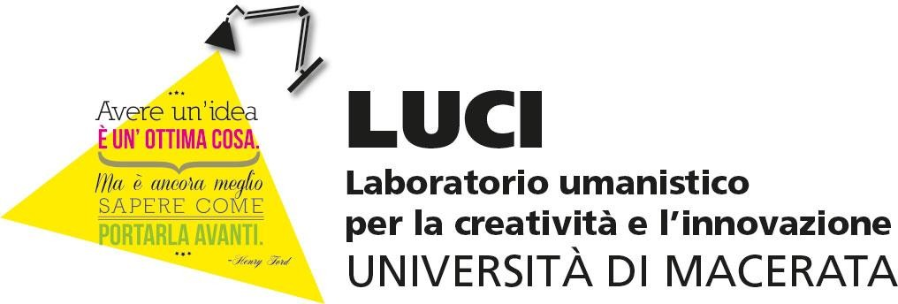
Laboratory for Humanism, Creativity and Innovation
lorenzo.compagnucci@unimc.it

Slide 43
LUCI
LUCI is the laboratory of UniMC for humanism, creativity and innovation
It promotes an “entrepreneurial approach” among undergraduate and
postgraduate students, graduates, and researchers in the SSHs
LUCI started in 2013, the 9th edition starts in the academic year 2021-2022
Structure: 4 months, 14 modules (6-7 hours each) on entrepreneurship, creativity
and innovation
The Lab trains young people in the SSHs and supports them in acquiring soft skills and interdisciplinary competences, by focusing on the cultural and creative domain
LUCI fosters cross-fertilization among students from the five UniMC Departments: Law; Economics and Law; Education, Cultural Heritage and Tourism; Political Science, Communication and International Relations; and Humanities (Languages, History, Arts, and Philosophy). In addition SSHs students work with STEM students
Students join multidisciplinary teams to elaborate an innovative business idea
lorenzo.compagnucci@unimc.it

Slide 44
LUCI
An overview of areas and activities
Company Basics: this area illustrates the preliminary tools for generating a business idea and analyzing innovation. Emphasis is also given to developing soft skills. Training is provided by professionals, innovators and academics.
Innovation Café: students are stimulated to develop an entrepreneurial, innovative and multidisciplinary approach to address complex challenges. Students encounter entrepreneurs and craftsmen from the cultural and creative domain. These experts offer support to the teams in developing their business ideas. Young entrepreneurs graduated from UniMC are also invited to share their personal and professional experience
Feed Your Idea: since the first meeting, students join multidisciplinary to develop their own business ideas. At the end of the course, the ideas are presented at the Pitch Day, in front of a public made up of students, scholars, entrepreneurs, investors and representatives of public institutions.
------ > Follow up: the best ideas and the most engaged teams are awarded with access to further training and support for participating in national and international competitions, as well as transferring the idea to the market
lorenzo.compagnucci@unimc.it

Slide 45
LUCI
Edition | Academic year | Partners | Participants | Business ideas
I | 2013-2014 | Leading firms | 47 | 8
II | 2014-2015 | Leading firms | 31 | 6
III | 2015-2016 | Leading firms Chamber of Commerce MC | 100 | 13
IV | 2016-2017 | Leading firms Polytechnic University of Marche University of Urbino High schools | 40 | 8
V | 2017-2018 | Leading firms Polytechnic University of Marche University of Urbino High schools ENACTUS | 35 | 7
VI | 2018-2019 | Leading firms Polytechnic University of Marche University of Urbino High schools Municipality of Macerata | 32 | 5
VII | 2019-2020 | Leading firms Polytechnic University of Marche University of Urbino High schools Municipality of Macerata | 43 | 7
VIII | 2020-2021 | Leading firms Polytechnic University of Marche University of Urbino | 42 | 7
 | TOTAL |  | 370 | 61
lorenzo.compagnucci@unimc.it

Slide 46
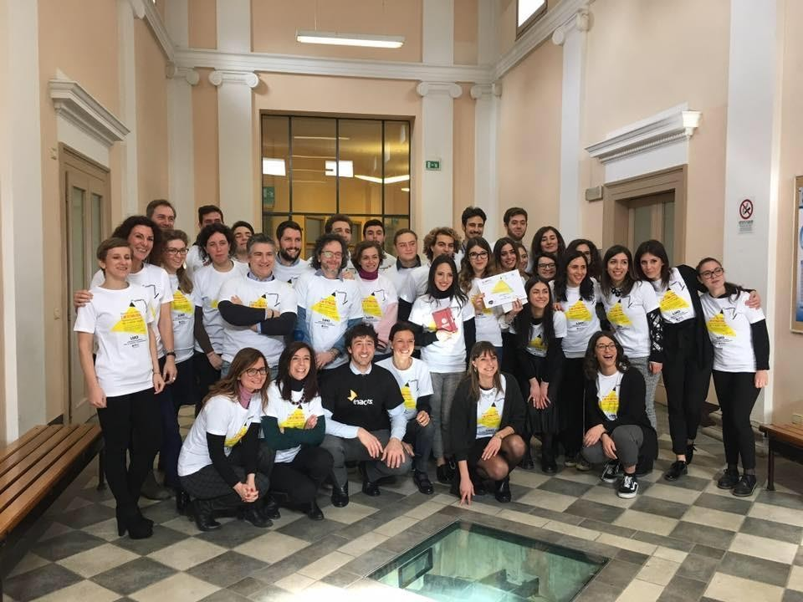
LUCI
lorenzo.compagnucci@unimc.it

Slide 47
Culture and Creativity Club
lorenzo.compagnucci@unimc.it

Slide 48
Culture and Creativity Club
Culture and Creativity Cluvb (C&CC) is a crowdsourcing contest to contribute to bridging the gap between knowledge production and the commercial success of innovative products, processes and services in the cultural and creative sector
C&CC is promoted by CreaHUB (co-working space of UniMC) in collaboration with META Group
S.r.l. and Symbola, Fondazione per le Qualità Italiane. In 2016 the project was awarded and
financed by the Italian Ministry of Education, University and Research (MIUR)
C&CC promotes innovation and digitalization as key factors to foster skilled graduates and companies in the cultural and creative domain
C&CC is based on an virtual platform
C&CC selects, awards and promotes eleven innovative ideas that address eleven challenges in the following industries: publishing; animation; home entertainment; video-gaming, and lifelong learning for professionals
The challenges are proposed by UniMC partner firms which are nationally and internationally known in the cultural and creative sector. These firms usually collaborate with UniMC to develop applied research projects and to foster student employability (internships, industrial Ph.D.)
Citizens, students, associations, professionals and companies are invited to reply to the challenges by proposing innovative solutions. The best innovators are awarded with a program to develop the solution and to transfer it to the market, also benefitting from the support of the partner companies
lorenzo.compagnucci@unimc.it

Slide 49
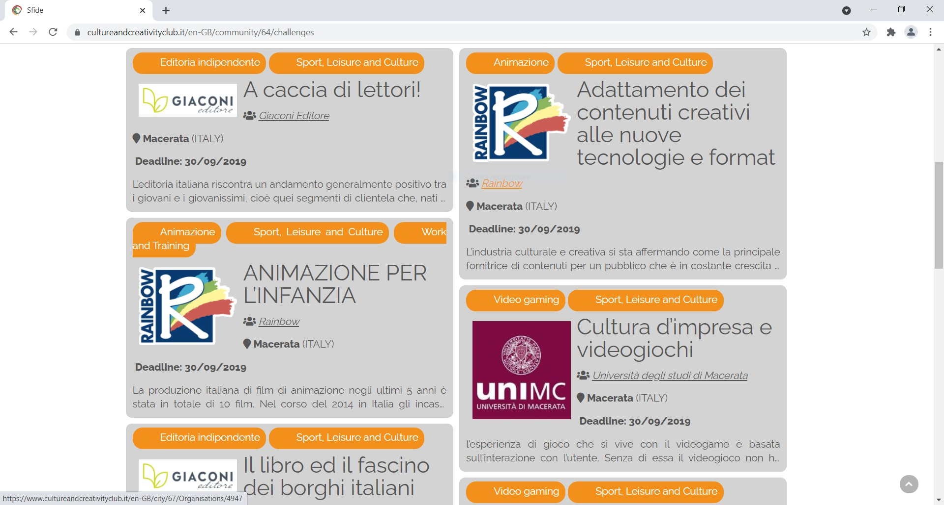
Culture and Creativity Club
lorenzo.compagnucci@unimc.it

Slide 50
Thank you for your attention!
Lorenzo Compagnucci
University of Macerata – Department of Law Office Valorisation of Research ILO and Placement
lorenzo.compagnucci@unimc.it Institutional page - ResearchGate - Google Scholar
lorenzo.compagnucci@unimc.it

Slide 51
Impact of Social Sciences, Humanities and Arts
13-15 October, 2021
Thank you!
#SSHA21

